Slide 1
ATAI
Advanced Technique of Artificial Intelligence
ATAI
ChongqingUniversity _{AdvancedTechniqueof}
of Technology Artificial Intelligence
Chongqing University of
Technology
Chongqing University ^{ATAI}
_{of Technology} Advanced Techniqueof
Artificial Intelligence
Chongqing University of Technology
Chongqing University of Technology
MotionStone: Decoupled Motion Intensity Modulation with Diffusion
Transformer for Image-to-Video Generation
Code : None.
—— CVPR2025
Reported by Jing Li
1

Slide 2
ATAI
Advanced Technique of Artificial Intelligence
ATAI
ChongqingUniversity _{AdvancedTechniqueof}
of Technology Artificial Intelligence
Chongqing University of
Technology
Chongqing University ^{ATAI}
_{of Technology} Advanced Techniqueof
Artificial Intelligence
Chongqing University of Technology
Chongqing University of Technology
Introduction
1、Humans can clearly distinguish between object motion and camera motion when watching a video. However, in existing video generation and motion estimation methods, object motion and camera motion are typically treated as a combined entity, failing to reflect the human perceptual ability to differentiate between these motions. This leads to a lack of precision and poor controllability in the model when generating videos.

Slide 3
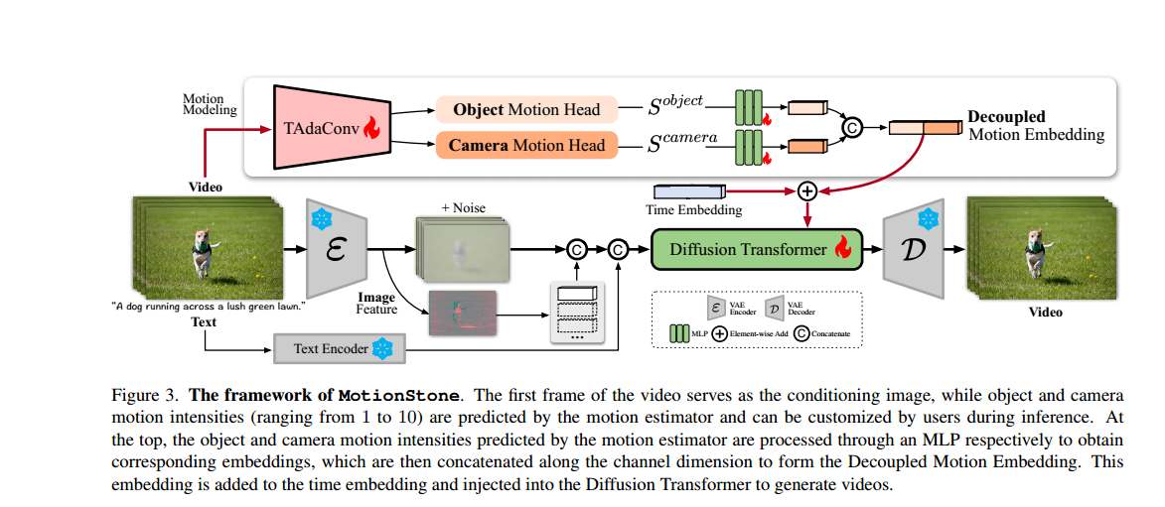
ATAI
Advanced Technique of Artificial Intelligence
ATAI
ChongqingUniversity _{AdvancedTechniqueof}
of Technology Artificial Intelligence
Chongqing University of
Technology
Chongqing University ^{ATAI}
_{of Technology} Advanced Techniqueof
Artificial Intelligence
Chongqing University of Technology
Chongqing University of Technology
Overview

Slide 4
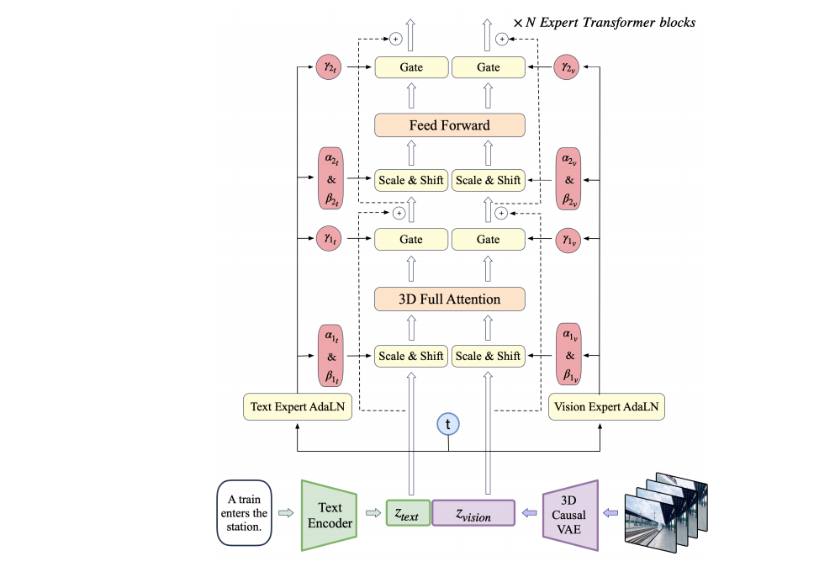
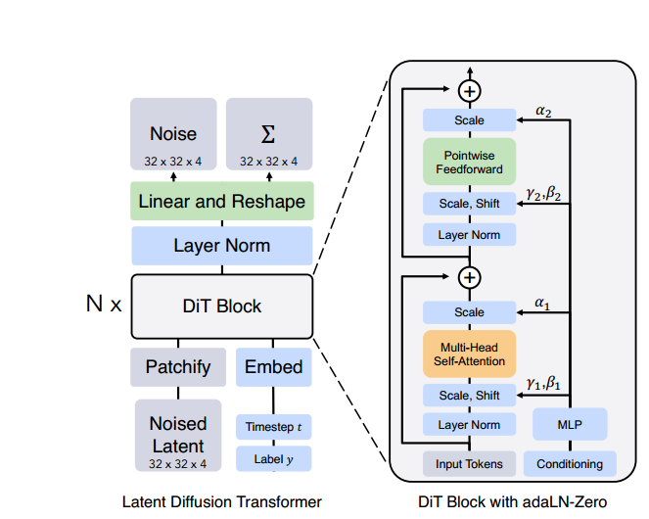
ATAI
Advanced Technique of Artificial Intelligence
ATAI
ChongqingUniversity _{AdvancedTechniqueof}
of Technology Artificial Intelligence
Chongqing University of
Technology
Chongqing University ^{ATAI}
_{of Technology} Advanced Techniqueof
Artificial Intelligence
Chongqing University of Technology
Chongqing University of Technology
Overview

Slide 5
ATAI
Advanced Technique of Artificial Intelligence
ATAI
ChongqingUniversity _{AdvancedTechniqueof}
of Technology Artificial Intelligence
Chongqing University of
Technology
Chongqing University ^{ATAI}
_{of Technology} Advanced Techniqueof
Artificial Intelligence
Chongqing University of Technology
Chongqing University of Technology
Method

Slide 6
ATAI
Advanced Technique of Artificial Intelligence
ATAI
ChongqingUniversity _{AdvancedTechniqueof}
of Technology Artificial Intelligence
Chongqing University of
Technology
Chongqing University ^{ATAI}
_{of Technology} Advanced Techniqueof
Artificial Intelligence
Chongqing University of Technology
Chongqing University of Technology
Method

Slide 7
ATAI
Advanced Technique of Artificial Intelligence
ATAI
ChongqingUniversity _{AdvancedTechniqueof}
of Technology Artificial Intelligence
Chongqing University of
Technology
Chongqing University ^{ATAI}
_{of Technology} Advanced Techniqueof
Artificial Intelligence
Chongqing University of Technology
Chongqing University of Technology
Method

Slide 8
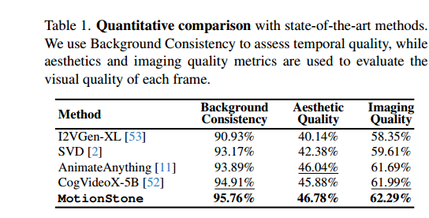
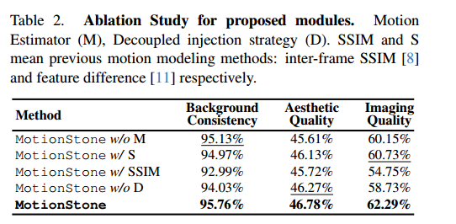
ATAI
Advanced Technique of Artificial Intelligence
ATAI
ChongqingUniversity _{AdvancedTechniqueof}
of Technology Artificial Intelligence
Chongqing University of
Technology
Chongqing University ^{ATAI}
_{of Technology} Advanced Techniqueof
Artificial Intelligence
Chongqing University of Technology
Chongqing University of Technology
Experiments

Slide 9
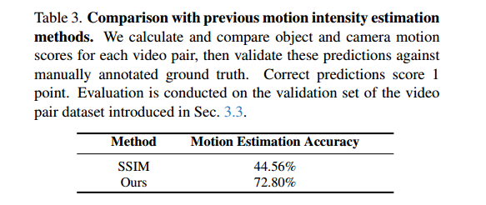
ATAI
Advanced Technique of Artificial Intelligence
ATAI
ChongqingUniversity _{AdvancedTechniqueof}
of Technology Artificial Intelligence
Chongqing University of
Technology
Chongqing University ^{ATAI}
_{of Technology} Advanced Techniqueof
Artificial Intelligence
Chongqing University of Technology
Chongqing University of Technology
Experiments

Slide 10
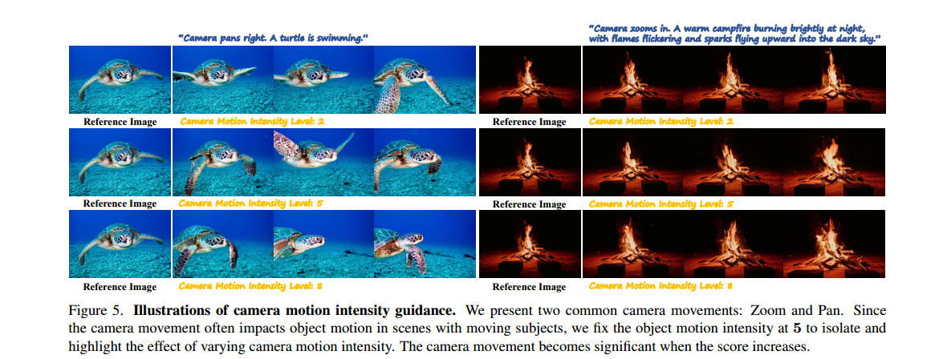
ATAI
Advanced Technique of Artificial Intelligence
ATAI
ChongqingUniversity _{AdvancedTechniqueof}
of Technology Artificial Intelligence
Chongqing University of
Technology
Chongqing University ^{ATAI}
_{of Technology} Advanced Techniqueof
Artificial Intelligence
Chongqing University of Technology
Chongqing University of Technology
Experiments

Slide 11
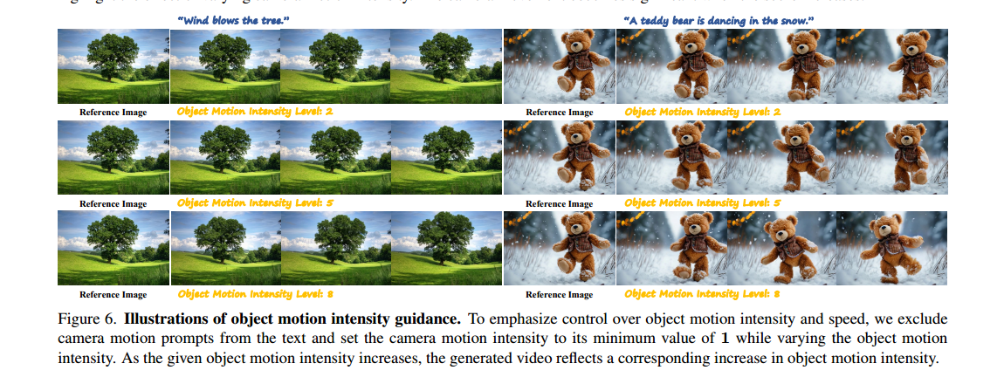
ATAI
Advanced Technique of Artificial Intelligence
ATAI
ChongqingUniversity _{AdvancedTechniqueof}
of Technology Artificial Intelligence
Chongqing University of
Technology
Chongqing University ^{ATAI}
_{of Technology} Advanced Techniqueof
Artificial Intelligence
Chongqing University of Technology
Chongqing University of Technology
Experiments

Slide 12
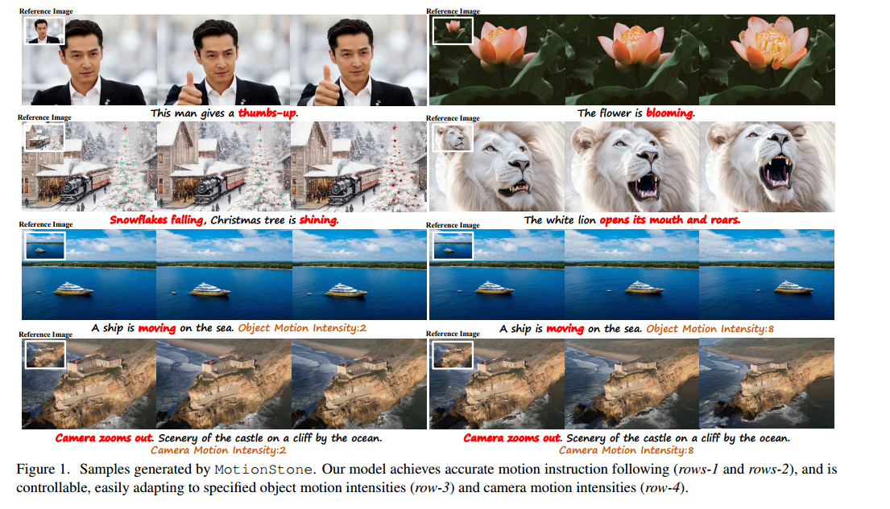
ATAI
Advanced Technique of Artificial Intelligence
ATAI
ChongqingUniversity _{AdvancedTechniqueof}
of Technology Artificial Intelligence
Chongqing University of
Technology
Chongqing University ^{ATAI}
_{of Technology} Advanced Techniqueof
Artificial Intelligence
Chongqing University of Technology
Chongqing University of Technology
Experiments

Slide 13
ATAI
Advanced Technique of Artificial Intelligence
ATAI
ChongqingUniversity _{AdvancedTechniqueof}
of Technology Artificial Intelligence
Chongqing University of
Technology
Chongqing University ^{ATAI}
_{of Technology} Advanced Techniqueof
Artificial Intelligence
Chongqing University of Technology
Chongqing University of Technology
Thanks!

